Slide 1
Lecture 8 - Authentication and access control
COM744: Security and Risk Management
Nigel Houlden / Jason Davies
n.houlden@glyndwr.ac.uk / Jason.Davies@glyndwr.ac.uk

Slide 2
Authentication Definition
RFC 4949 defines user authentication as:
“The process of verifying an identity claimed by or for a system entity.”

Slide 3
Authentication
The act of proving that a user is who they say they are
Methods:
Something the user knows
Something the user is
Something user has

Slide 4
Authentication Process
Basis for access control and user accountability
Identification step
Presenting an identifier to the security system
Verification step
Presenting or generating authentication information that corroborates the binding between the entity and the identifier

Slide 5
Something You Know
Passwords
Security questions
Attacks on “something you know”

Slide 6
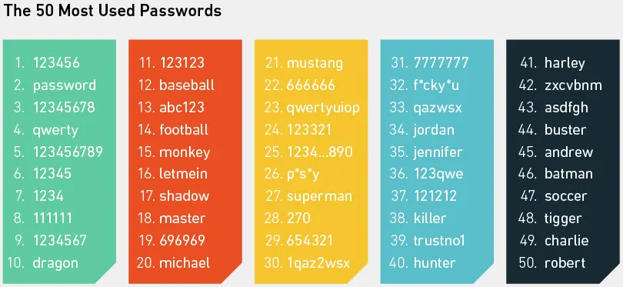
Password Types
https://wpengine.com/resources/passwords-unmasked-infographic/

Slide 7
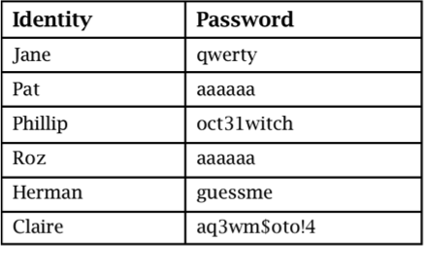
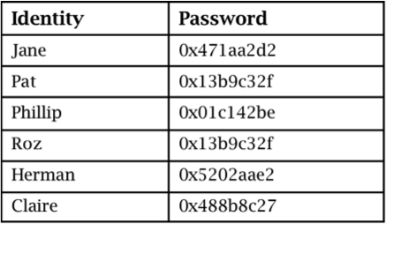
Password Storage
Plaintext
Concealed

Slide 8
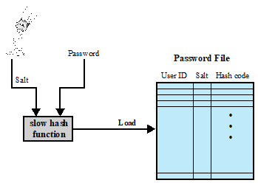
Adding a new password

Slide 9
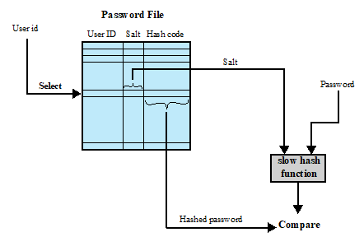
Verifying a password

Slide 10
Password Vulnerabilities
Offline dictionary attack
Specific account attack
Popular password attack
Password guessing against single user
Workstation hijacking
Exploiting user mistakes
Exploiting multiple password use
Electronic monitoring

Slide 11
Password Cracking
Dictionary attacks
Develop a large dictionary of possible passwords and try each against the password file
Each password must be hashed using each salt value and then compared to stored hash values
Rainbow table attacks
Pre-compute tables of hash values for all salts
A mammoth table of hash values
Can be countered by using a sufficiently large salt value and a sufficiently large hash length

Slide 12
Password Cracking
Password crackers exploit the fact that people choose easily guessable passwords
Shorter password lengths are also easier to crack
John the Ripper
Open-source password cracker first developed in in 1996
Uses a combination of brute-force and dictionary techniques

Slide 13
Modern Approaches
Complex password policy
Forcing users to pick stronger passwords
However password-cracking techniques have also improved
The processing capacity available for password cracking has increased dramatically
Sophisticated algorithms to generate potential passwords
Studying examples and structures of actual passwords in use

Slide 14
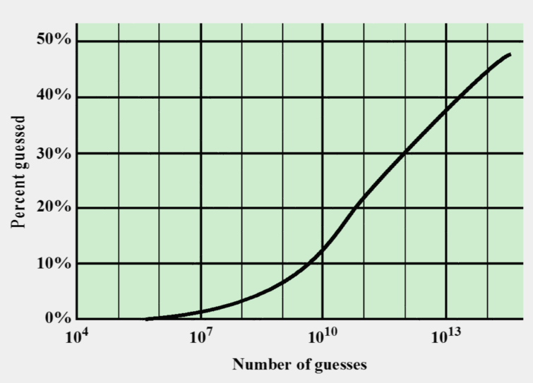
Correct Password Guesses

Slide 15
Password File Access Control
Can block offline guessing attacks by denying access to encrypted passwords
Make available only to privileged users
Shadow password file
Vulnerabilities
Weakness in the OS that allows access to the file
Accident with permissions making it readable
Users with same password on other systems
Access from backup media
Sniff passwords in network traffic

Slide 16
Password Selection Strategies
User education
Users can be told the importance of using hard to guess passwords and can be provided with guidelines for selecting strong passwords
Computer generated passwords
Users have trouble remembering them

Slide 17
Password Selection Strategies
Reactive password checking
System periodically runs its own password cracker to find guessable passwords
Complex password policy
User is allowed to select their own password, however the system checks to see if the password is allowable, and if not, rejects it
Goal is to eliminate guessable passwords while allowing the user to select a password that is memorable

Slide 18
Proactive Password Checking
Rule enforcement
Specific rules that passwords must adhere to
Password cracker
Compile a large dictionary of passwords not to use
Bloom filter
Used to build a table based on dictionary using hashes
Check desired password against this table

Slide 19
Biometrics: Something You Are

Slide 20
Problems with Biometrics
Intrusive
Expensive
Single point of failure
Sampling error
False readings
Speed
Forgery

Slide 21
Biometric Authentication
Attempts to authenticate an individual based on unique physical characteristics
Based on pattern recognition
Is technically complex and expensive when compared to passwords and tokens
Physical characteristics used include:
Facial characteristics
Fingerprints
Hand geometry
Retinal pattern
Iris
Signature
Voice

Slide 22
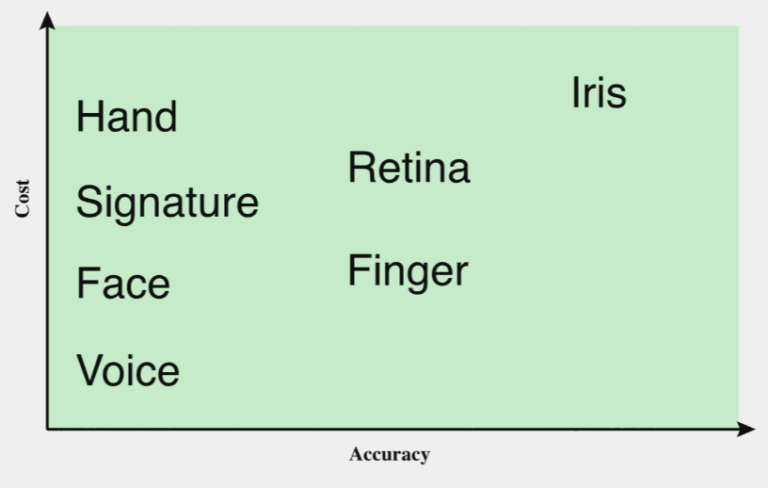
Biometrics – Cost vs. Accuracy

Slide 23
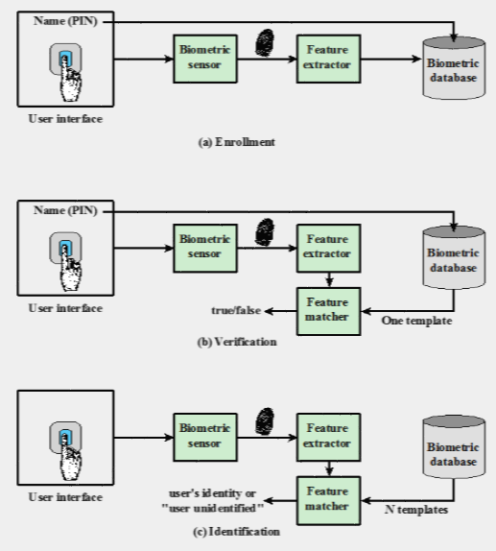
Authentication Process

Slide 24
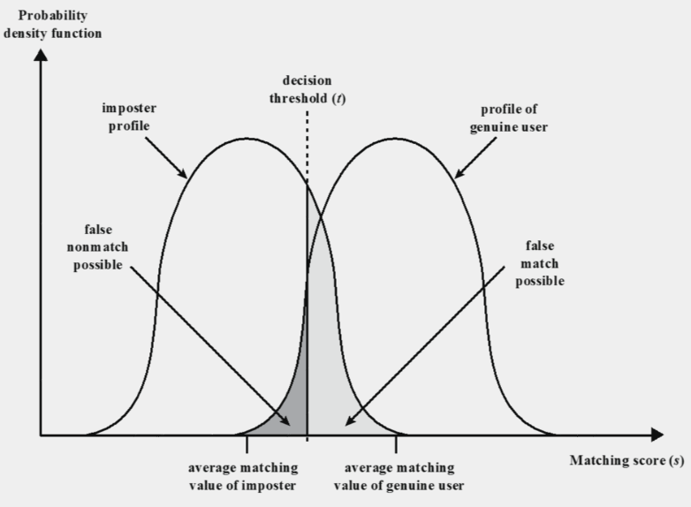
Biometric Matching

Slide 25
Tokens: Something You Have

Slide 26
Types of Cards Used as Tokens

Slide 27
Memory Cards
Can store but do not process data
The most common is the magnetic stripe card
Can include an internal electronic memory
Can be used alone for physical access
Hotel room
ATM
Provides significantly greater security when combined with a password or PIN
Drawbacks of memory cards include:
Requires a special reader
Loss of token
User dissatisfaction

Slide 28
Smart Tokens
Physical characteristics:
Include an embedded microprocessor
A smart token that looks like a bank card
Can look like calculators, keys, small portable objects
Interface:
Manual interfaces include a keypad and display for interaction
Electronic interfaces communicate with a compatible reader/writer

Slide 29
Risk Assessment for User Authentication
There are three separate concepts:
Assurance Level
Potential impact
Areas of risk

Slide 30
Assurance Level
Describes an organisation’s degree of certainty that a user has presented a credential that refers to his or her identity
The degree of confidence in the vetting process used to establish the identity of the individual to whom the credential was issued
The degree of confidence that the individual who uses the credential is the individual to whom the credential was issued

Slide 31
Levels of Assurance
Four levels of assurance
Level 1 - Little or no confidence in the asserted identity's validity
Level 2 - Some confidence in the asserted identity’s validity
Level 3 - High confidence in the asserted identity's validity
Level 4 - Very high confidence in the asserted identity’s validity

Slide 32
Potential Impact
FIPS 199 defines three levels of potential impact on organisations or individuals should there be a breach of security:
Low: An authentication error could be expected to have a limited adverse effect on organisational operations, organisational assets, or individuals
Moderate: An authentication error could be expected to have a serious adverse effect
High: An authentication error could be expected to have a severe or catastrophic adverse effect

Slide 33
Potential Impacts for Each Assurance Level

Slide 34
Remote User Authentication
Authentication over a network, the Internet, or a communications link is more complex
Additional security threats such as:
Eavesdropping, capturing a password, replaying an authentication sequence that has been observed
Generally rely on some form of a challenge-response protocol to counter threats

Slide 35
Authentication Security Issues
Denial-of-Service
Attempts to disable a user authentication service by flooding the service with numerous authentication attempts
Trojan Horse
An application or physical device masquerades as an authentic application or device for the purpose of capturing a user password, passcode, or biometric
Client Attacks
Adversary attempts to achieve user authentication without access to the remote host or the intervening communications path

Slide 36
Authentication Security Issues
Replay
Adversary repeats a previously captured user response
Host Attacks
Directed at the user file at the host where passwords, token passcodes, or biometric templates are stored
Eavesdropping
Adversary attempts to learn the password by some sort of attack that involves the physical proximity of user and adversary

Slide 37
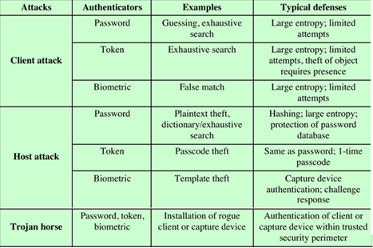
Authentication Attack Mitigation

Slide 38
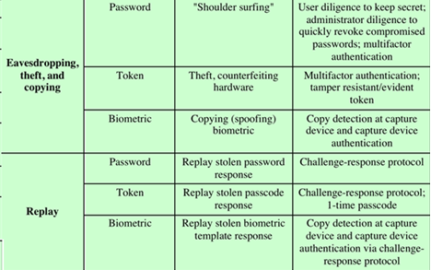
Authentication Attack Mitigation

Slide 39
Authentication Summary
Electronic user authentication principles
Password-based authentication
Token-based authentication
Biometric authentication
Remote user authentication
Security issues for user authentication

Slide 40
Part 2- Access control

Slide 41
What we will cover
Access control principles
Discretionary access control
UNIX file access control
Access control lists in UNIX
Role-based access control

Slide 42
Access Control Principles
RFC 4949 defines computer security as:
“Measures that implement and assure security services in a computer system, particularly those that assure access control service.”

Slide 43
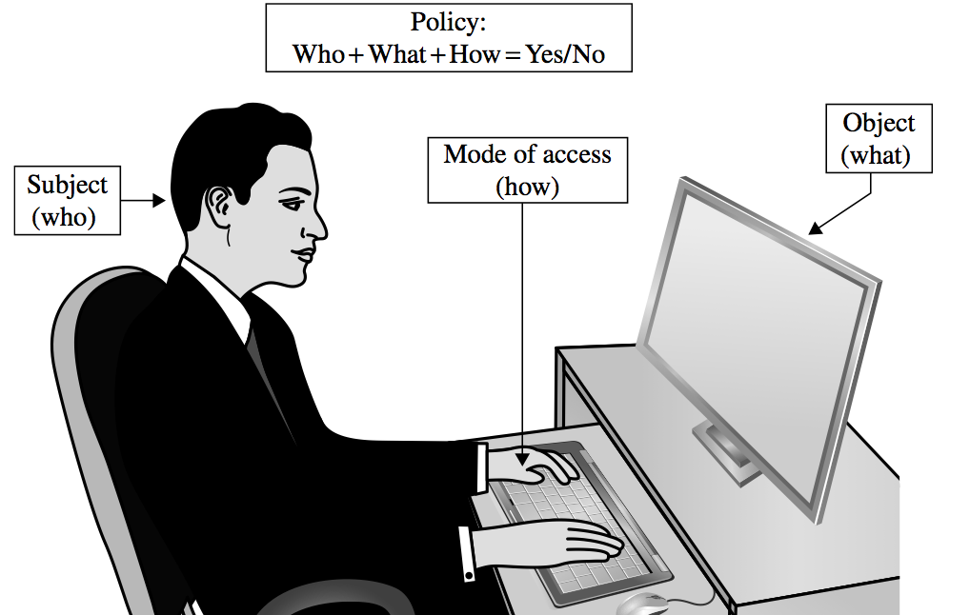
Access Control

Slide 44
Access Policies
Goals:
Check every access
Enforce least privilege
Verify acceptable usage
Track users’ access
Enforce at appropriate granularity
Use audit logging to track accesses

Slide 45
Implementing Access Control
Access control directory
Access control matrix
Access control list
Privilege list
Capability
Procedure-oriented access control
Role-based access control

Slide 46
Access Control Policies
Discretionary access control (DAC)
Controls access based on the identity of the requestor and on access rules (authorisations) stating what requestors are (or are not) allowed to do
Mandatory access control (MAC)
Controls access based on comparing security labels with security clearances

Slide 47
Access Control Policies
Role-based access control (RBAC)
Controls access based on the roles that users have within the system and on rules stating what accesses are allowed to users in given roles
Attribute-based access control (ABAC)
Controls access based on attributes of the user, the resource to be accessed, and current environmental conditions

Slide 48
Discretionary Access Control (DAC)
Scheme in which an entity may enable another entity to access some resource
Often provided using an access matrix
One dimension consists of identified subjects that may attempt data access to the resources
The other dimension lists the objects that may be accessed
Each entry in the matrix indicates the access rights of a particular subject for a particular object

Slide 49
Access Control Directory

Slide 50
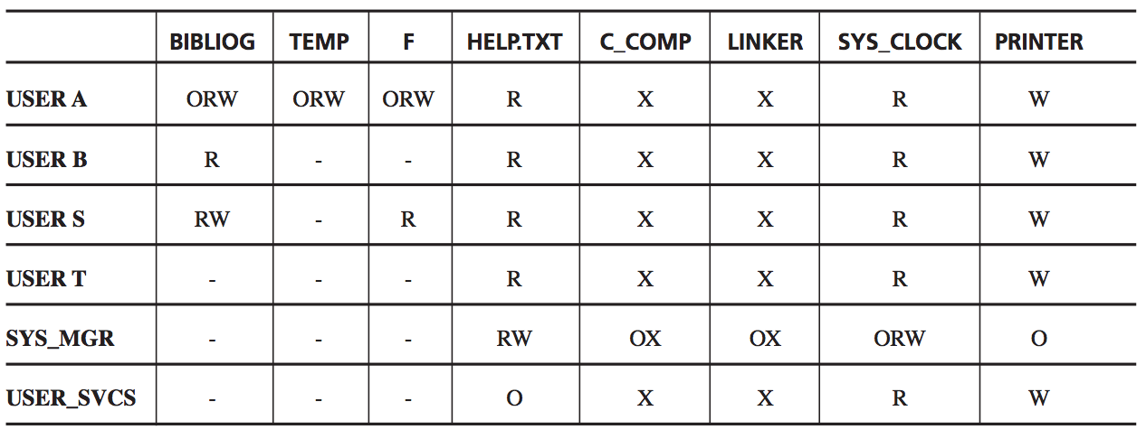
Access Control Matrix

Slide 51
Access Control List

Slide 52
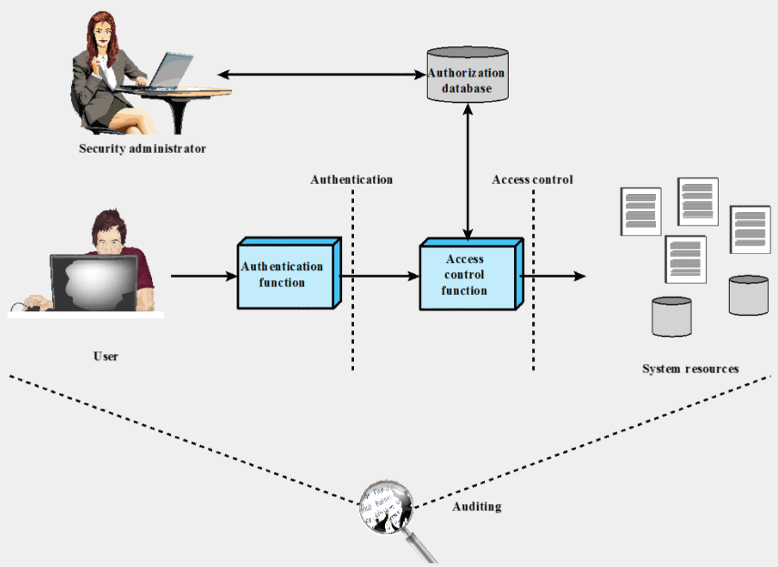
Access Control Relationships

Slide 53
Subjects and Objects
Subject
An entity capable of accessing objects
Three classes: Owner, Group, World
Object
A resource to which access is controlled
Entity used to contain and/or receive information

Slide 54
Access Rights
Access right
Describes the way in which a subject may access an object
Could include:
Read
Write
Execute
Delete
Create
Search

Slide 55
UNIX File Access Control
UNIX files are administered using inodes (index nodes)
File attributes, permissions and control information are sorted in the inode
On the disk there is an inode table, or inode list, that contains the inodes of all the files in the file system
When a file is opened its inode is brought into main memory and stored in a memory resident inode table
Directories are structured in a hierarchical tree
May contain files and/or other directories
Contains file names plus pointers to associated inodes

Slide 56
UNIX File Access Control
Unique user identification number (user ID)
Member of a primary group identified by a group ID
Belongs to a specific group
12 protection bits
Specify read, write, and execute permission for the owner of the file, members of the group and all other users

Slide 57
UNIX File Access Control
“Set user ID”(SetUID)
“Set group ID”(SetGID)
System temporarily uses rights of the file owner/group in addition to the real user’s rights when making access control decisions
Enables privileged programs to access files/resources not generally accessible
Sticky bit
When applied to a directory it specifies that only the owner of any file in the directory can rename, move, or delete that file
Superuser
Is exempt from usual access control restrictions
Has system-wide access

Slide 58
Unix Access Control Lists (ACLs)
Modern UNIX systems support ACLs
FreeBSD, OpenBSD, Linux, Solaris
FreeBSD
Setfacl command assigns a list of UNIX user IDs and groups
Any number of users and groups can be associated with a file
Read, write, execute protection bits
A file does not need to have an ACL
Includes an additional protection bit that indicates whether the file has an extended ACL
When a process requests access to a file system object two steps are performed:
Step 1 selects the most appropriate ACL
Step 2 checks if the matching entry contains sufficient permissions

Slide 59
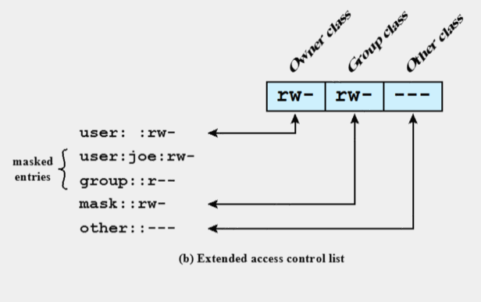
Extended Access Control List

Slide 60
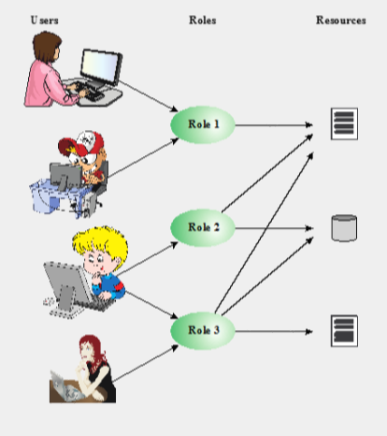
Users, Roles and Resources

